Slide 1

June 2022
A new paradigm
The drivers & outlook for Australian Agriculture Commodities
@MecardoAnalysis

Slide 2
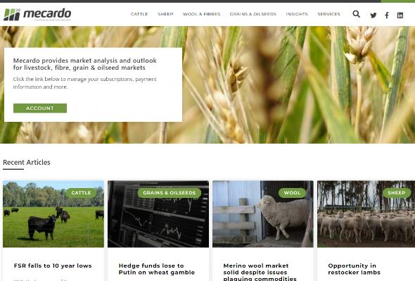
What is Mecardo?
Nutrien Ag Solutions commodity market insights.
Services:
  Commodity news & analysis website subscription - public
Core commodities:
  Beef
  Sheep & Lamb
  Grain & oilseeds
  Wool
Notes:
So What is Mecardo?
Mecardo is a Nutrien Ag Solutions business that provides commodity market research, insights and strategic advice.
There are a couple arms to what we do- firstly, there is our commodity news and research service, delivered through our website Mecardo.com.au. Some of the content is free each month, and more avid readers can sign up for a premium subscription for full access. There is also a free weekly podcast – Commodity conversations.
Secondly, we provide research services, data and insight presentations like this one to the Nutrien Network, and selected private clients like Simplot, & Hewitt Cattle Australia which helps ensure that the Nutrien personnel our customers come into contact with can be informed and knowledgeable about commodity markets, and risk management strategies available to producers.
We cover the main commodities Nutrien customers are involved with- beef, sheep & lamb, Grains & oilseeds and wool. Plus we have the capability to conduct targeted research in other niche areas as required.

Slide 3
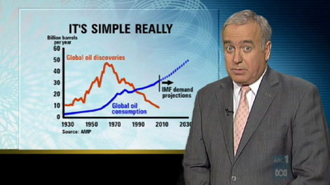


“The story is more important than the data”
“Mecardo are the guys who made market data sexy!”
“It’s all about the story”
Notes:
At Mecardo we have a logical process in analyzing opportunities and providing advice; we start with data, facts & figures. We know there is plenty of data around, but we also know that the data alone is not where the ultimate value is, it is the story based on the data that is where the substance is.
We all accept that Allan Koehler has the data behind his nightly stories that explain to us “what it means?”
Mecardo retains the largest privately held set of agricultural commodity price & supply data in Australia, but it is the stories that the data yields that provides the value.
We pride ourselves on this ability to understand the data, apply our experience and then “tell the story”.
It helps when the story is upbeat; the story I am going to tell could become both the greatest challenge & the greatest opportunity broad acre agriculture has seen in our lifetime.

Slide 4
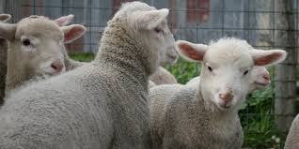
There are some “big” stories ……!
1
African Swine Fever
2
Population – growing wealthier
3
New free trade agreements
4
Rebuild of the flock/herd
5
Russia/Ukraine war
6
  Covid-19
Notes:
But first lets understand where we are by looking at the macro influences on the red meat market right now.
These are the big stories of recent times; and they will all have varying impacts on the future for red meat prices.
You will note that we are talking at the moment about “red meat” not beef, lamb or mutton. The fact is that all of the “red meat” produced in Australia has or will to varying degrees be impacted by these “big” impacts.
In relation to Covid-19, logistics (processors) is the big issue weighing on red meat – this will continue into the future.
This could be roughly classified as the “known unknowns”, and in some respects the Mecardo model is good at providing outlook based on this information.
From there we will need to weigh up the relative importance of each of these impacts. This is where we get into the “unknown unknown’s”, (with apologies to Donald Rumsfeld). Be under no illusion that we will not at this time be able to appropriately assess these, the best we can do is continue to follow the changing scene we are presented and to re-assess as things become clearer.

Slide 5
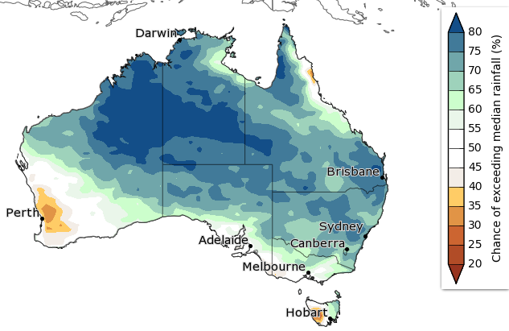
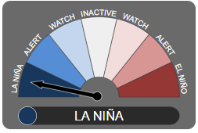
Seasonal Outlook
BOM 3 month predictions strong
Recent poor finish to monsoon in Northern Australia
LaNina effect still in play
A reversion to a neutral, or inactive ENSO system is expected to occur this winter, but no sign yet.
AussieGrass model suggests pasture growth in the period JUL- SEP 2022 will be weaker than 2020-21
Source: Refinitiv, Profarmer, Mecardo
Notes:
BOM forecasts 70-80% plus chance of above average rainfall for much of NSW from may to July.
La Nina phenomenon still influencing weather systems in Australia, but beginning to weaken.
A neutral El Nino Southern Oscillation (ENSO) is expected to take hold.
This is positive for producers, as the emergence of La Nina’s brother, El Nino would normally spell more extreme, drier and less favourable conditions.
Pasture growth over the upcoming 2022 period are expected to disappoint compared to the exceptional last couple years since the drought broke, but are still tipped to deliver better results than back in 2015.

Slide 6
RED MEAT
Price & Outlook Update
Notes:
Good news story-
Questions
Introduce mecardo

Slide 7


Understanding the path to wealth in the developing world
Starts with industrialization (this requires Minerals!!)
Movement from rural and regional areas to cities with higher income potential
Family wealth grows (GDP builds)
Nations with high proportions of urbanized populations tend to have higher GDP.
Notes:
Transformation of economies from rural subsistence farming to industrialised nations.
Factories offering jobs lead to more people living in cities where there are more opportunities for higher incomes
Close proximity to markets and jobs combined with transport infrastructure like good roads, public transport mean people spend more time working, and less time travelling leading to higher productivity.
I.e. In China, the richest people are the ones living in major cities with opportunities.
Blue is wealthy, dark brown is dirt poor.
Economic Impacts - Impacts of Urbanisation (google.com)

Slide 8
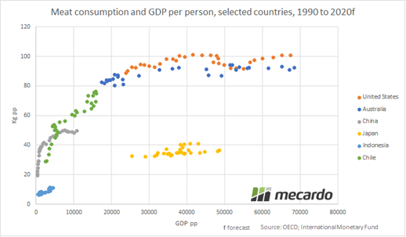
Demand grows in developing countries
Meat consumption increases as GDP increases
Chinese millennials are embracing western diets
Notes:
It needs to be remembered that the AFS impact is on top of already growing demand as a result of increased GDP growth in developing countries.
There is a well accepted model – those with greater spending capacity choose to introduce meat into their diets.
While in the developed world there is a robust discussion about how to reduce meat intake, in the developing world the objective is to consume western style diets.
The first demographic in China to generate the spending capacity allowing them to embrace red meat are the millennials. The scale of this demographic is mind-blowing, to provide perspective in China there are about 400 million millennials (the total US population is 329 million).
They are well connected and socially aware, with an aspiration to include a greater slice of their diets based on western style.
So while ASF is impacting, it is really just the “petrol on the fire” of what is already a well established and growing demand for red meat.

Slide 9

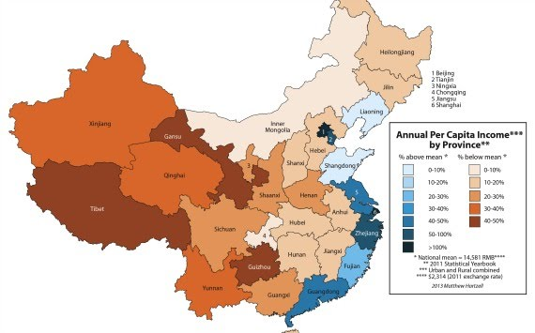
The path to wealth in the developing world
People in China’s big cities of Shanghai, Beijing, Shenzhen have higher incomes on average compared to rural.
BEIJING
SHANGHAI
SHENZHEN
Source:
Notes:
Transformation of economies from rural subsistence farming to industrialised nations.
Factories offering jobs lead to more people living in cities where there are more opportunities for higher incomes
Close proximity to markets and jobs combined with transport infrastructure like good roads, public transport mean people spend more time working, and less time travelling leading to higher productivity.
I.e. In China, the richest people are the ones living in major cities with opportunities.
Blue is wealthy, dark brown is dirt poor.
Economic Impacts - Impacts of Urbanisation (google.com)

Slide 10

The big population numbers are close to Australia
Notes:
To set the scene, the big population is in Asia, it is still growing economically, we are close and the big food demand is still ahead!

Slide 11
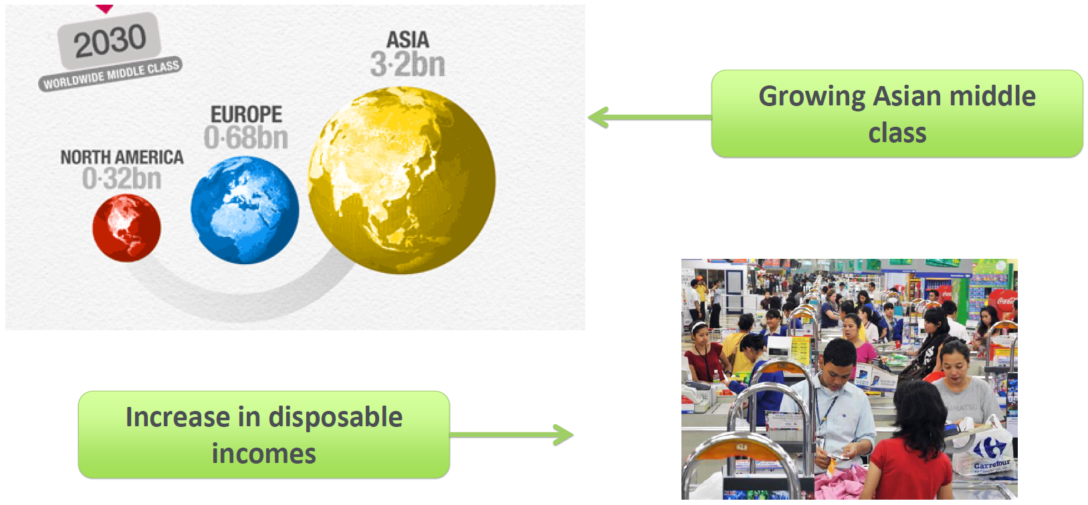
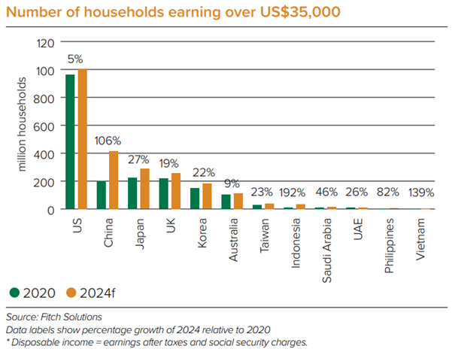
Notes:
Confirming the situation, by 2030 most of the middle class in the world will live in Asia.

Slide 12
Retail price of meat
Rare that meat prices backtrack in the last 20 years
Strong domestic market prices reflective of solid demand
Red meat prices are on the rise

Slide 13
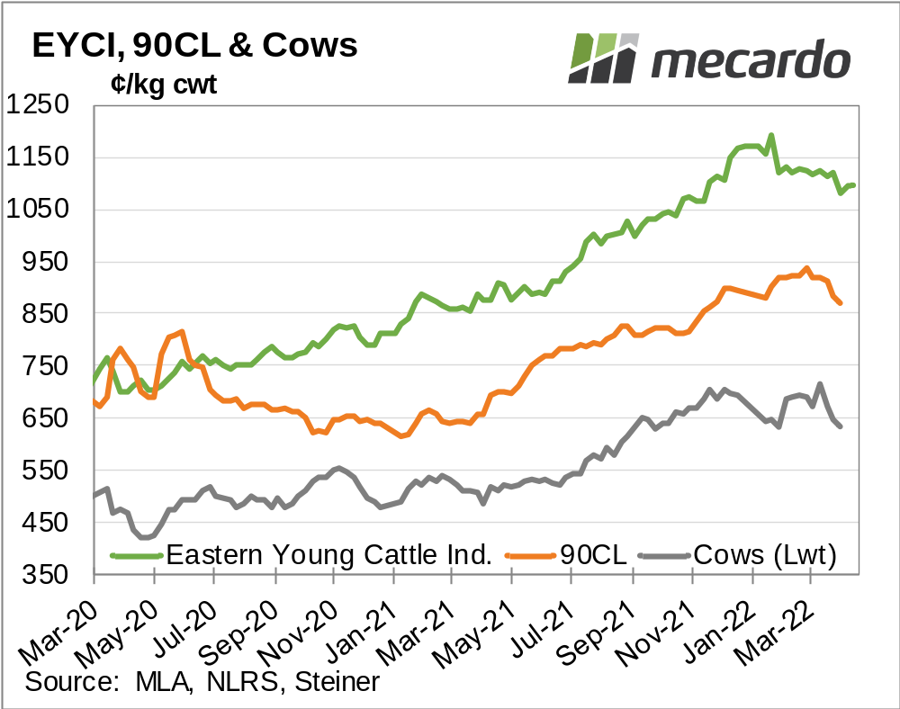

Cattle
EYCI ambling lower
….. after drought recovery
90CL hit all time highs before declining
Cow prices also reached peak
A poor Northern monsoon is a risk to restocker demand in 2022/23
Chinese import meat demand under threat- Hog herd recovery, COVID.
Notes:
PRICE
Has been driven by restocker activity – NSW & QLD
Some risk if monsoon is below average
Brazil has breached the TRQ/MFN quota into the US for beef, but product is still being sold at similar prices to remain competitive.- China Brazil’s main Beef customer and a diversification strategy may be being pursued.
China’s lockdowns and zero COVID policies threaten economic growth, consumer confidence, and especially foodservice demand for beef & lamb.
US drought sparking unprecedented cow cull rates , setting scene for lower calf crops in future years and rebuild related retention as the US herd recovers. Positive for med tolong term demand from the US for Aussie beef

Slide 14
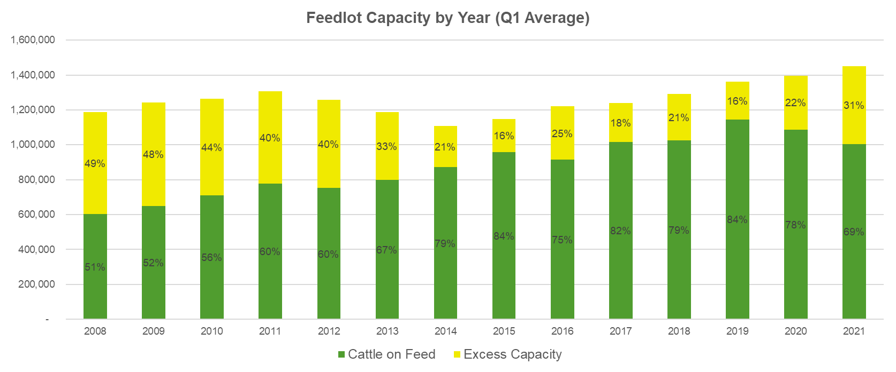
Feedlotting (CoF) a growing trend in beef production
March quarter cattle on feed numbers were the highest since December 2019
Grainfed slaughter over 50% of total slaughter
Feedlot excess capacity is at 31% - NSW & QLD centric.
The majority of feedlots are “privately” owned
  Around 22% of feedlot capacity is owned by processors
  Processors seeking consistent supply
Source: MLA, ALFA, Beefcentral, Beef2live
Notes:
SIDE DISH SLIDE
OECD-FAO Agricultural Outlook 2021-2030
Grain fed slaughter higher than 50% somewhat due to generally lower slaughter rates, and processors looking to feedlots to secure more reliable and consistent supply.
Grain fed export demand as well as domestic supermarkets are the drivers of cattle needing to be “on feed”
This trend will continue – growing global beef demand can only be met by increased feedlot numbers
Good for breeders!!!
Opportunity to build relationships – feedlots need secure & consistent supply

Slide 15
Herds on the rise
Notes:
USA -US herd fell in 2021, and cow liquidation suggests it will fall again in 2022. 2023 excepted to see herd rebuilds and beef production is expected to decline 6.8% YOY.
Brazil herd risen by ~100 million head in 20 years
Argentina’s cattle herd has not seen the steady growth that Brazil’s has, only booking a ~9% increase since 2000 from 50m to 53.5m head
South American countries collectively possess cattle herds in excess of ten times that of Australia,

Slide 16
Lamb
Long term price trend “higher high’s, higher lows”
Supply chain limitations impacting prices in 2022
Middle East export market declining in market share.
Export demand from non core destinations rising- diversification.
Source: MLA, Mecardo
Notes:
Change in fundamental basis of US demand due to COVID- more diverse base of consumers, less reliant on foodservice
Export demand for lamb from countries such as PNG, etc rising.

Slide 17
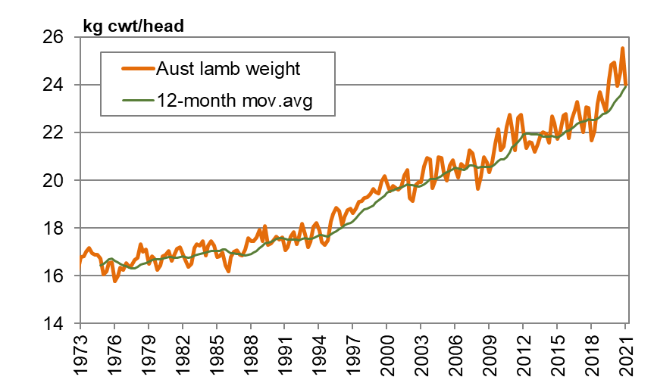
Long term lamb average carcase weights
25 year trend of rising lamb carcase weight
Heavy lambs match recent increasingly US-Centric export program & good seasonal conditions.
Backlog in lamb slaughter from labour issues and delayed turnoff will influence slaughter weight inflation.
Source: ABS, Mecardo
Notes:
Larger lambs on average turned off in Australia a product of changing needs from the market.
Australian Domestic and MENA export m,arkets still prefer smaller lamb sizes, but US export markets becoming more prominent in the destination mix for Australia.
US markets do not apply a penalty for larger lambs, so sizes have crept up as a result.

Slide 18
Is lamb the new Wagyu?
Source: Global Agritrends
Notes:
NZ strong reliance on China
Aussie stronger market share on US
This explains the strong support Australia has for heavy lamb carcases
Positive for producer (and Nutrien) returns

Slide 19





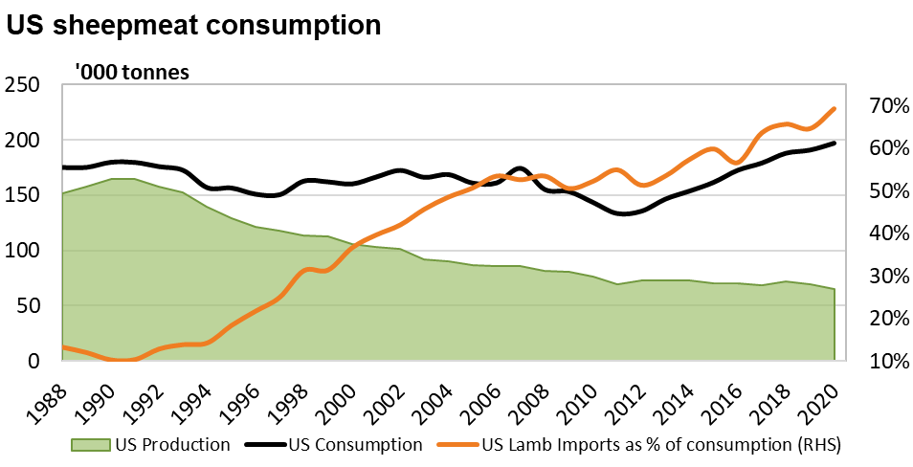
US market no longer cruising
US demand growth
Covid-19 has added demand
Expect this to continue
Source: DAWE., Mecardo
Notes:
~75% of sheepmeat produced exported. Heavy lambs exported from Australia rely on the US market and this year demand from the US has been one of the key drivers in rising exports. US number 1 lamb customer, taking 26% YTD . And it is a growing market, back in 2007, the US accounted for 28% of lamb exports, but it was a much smaller pie. For the year to date, the total volume of lamb exported to the US is 74% higher than in 2007, which points to the extraordinary growth of the market.
Why demand so strong? – covid – can see that the volume of lamb sent last year steady and this year stronger.
Cruises traditionally and restaurant trade. US gov Stimulus to family home. The increase in salaries for the lowest paid has seen more purchasing power in the home budgets and this is translating to more red meat purchases. Should stick* more people know how to cook. While US consumption has been growing since about 2011, their own domestic production has been decreasing since the 90s so the orange line shows how their reliance on imports as a proportion of total lamb consumption has been increasing.

Slide 20
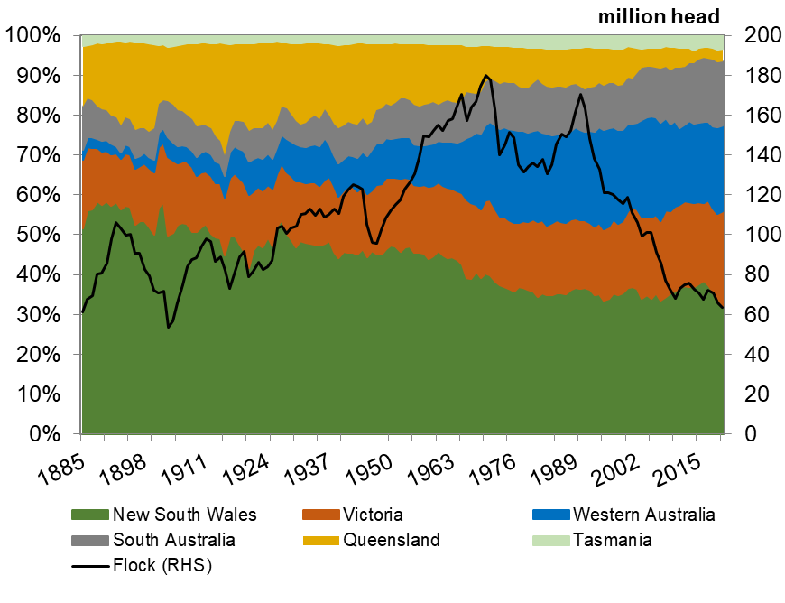
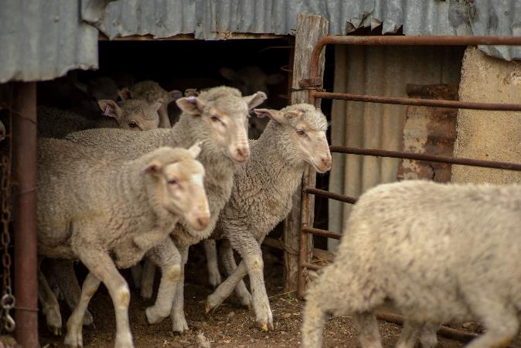
Australian flock decline
Source: ABS, MLA, Mecardo
Notes:
Global demand/consumption forecast to grow
Growth to come from “Developing”nations
Reduced NZ supply and anticipated flock rebuild in Australia to see our exports eclipse NZ in coming decade in terms of % market share of total sheepmeat exports

Slide 21
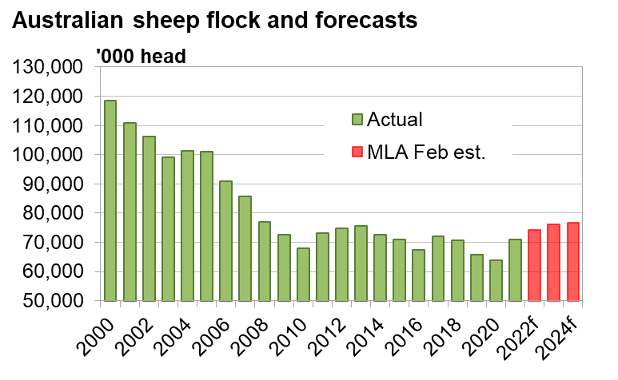
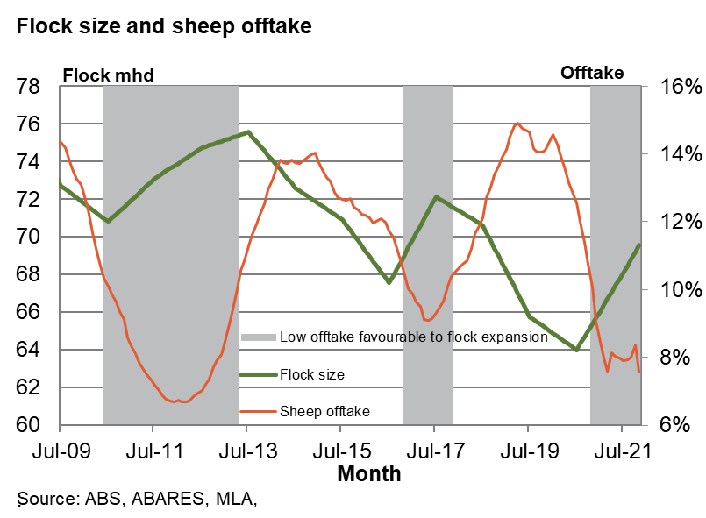
The flock rebuild
19% growth from 2020 to 2023f
Strong intention to rebuild
100 year low flock
Source: ABS, MLA, Mecardo, Independent Commodity Services
Notes:
Supply story
From 2000 to 2020 the sheep flock almost halved from nearly 120 million head to 64 million head.
2020- 100 year low flock
Swing from sheep to cropping and droughts having a big impact
Intention rebuild – good season, good price.
2021 70.6 million head
19% growth from 2020 to 2023. last time consecutive years of good seasonal conditions for rebuild after drought grew 11%

Slide 22
Lamb exports
Export demand is very good – processors doing well
Saleyard price spread to export values at records
Export volumes strong - close to average
Notes:
Lamb exports are “steady”
… but export values hit record levels
…. With ESTLI at record high discount to export values – processors are getting strong demand signals and good margins
Notwithstanding we need to consider added processor costs incurred
….. even if the ESTLI just returns to the bottom of the historical range compared to export values at 300¢ discount, it will lift it to 950¢. Over 1,000¢ is not out of the question if export values remain strong. With the Aussie dollar falling recently, it would appear there is added support & export values aren’t going to fall any time soon.

Slide 23

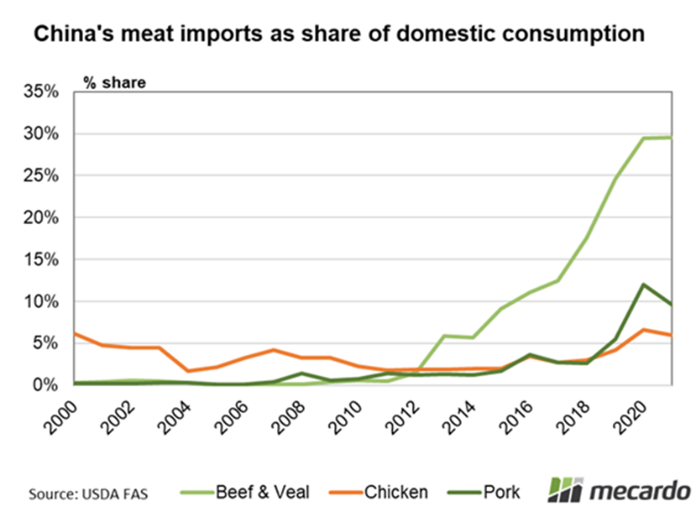

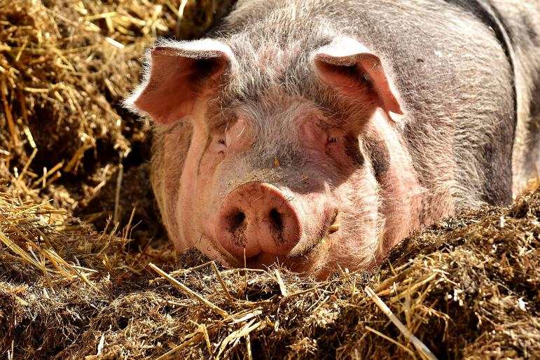
China - good or bad?
China key driver –
adding the heat since 2013
African Swine Fever
still a contributing factor
but for how long?
Source: DAWE, USDA FAS, Mecardo
Notes:
China. Despite the geopolitical sabre rattling, It has still been the major source of demand growth for red meat, and is a very important customer.
This chart shows us that China’s beef imports as a share of domestic consumption rising since 2013. Import growth (beef) up 24% each year
2018- ASF,
Prior to 2018 Half world pigs were in China (backyards), slaughtered half. 25% of worlds pork supply gone.
Completely disrupted the red meat trade around the globe and they became a vacuum of protein.
And this has been the major driver in red meat demand growth not just for countries that are directly exporting to China but it has redirected normal trade flows and created gaps.
But there is certainly no expectation that ramping up their own production is going to meet the pace that demand is growing for red meat by their population.

Slide 24
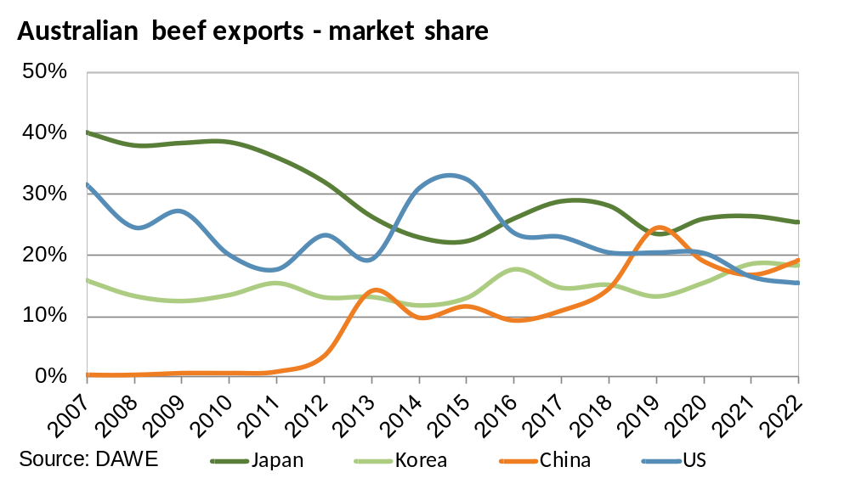
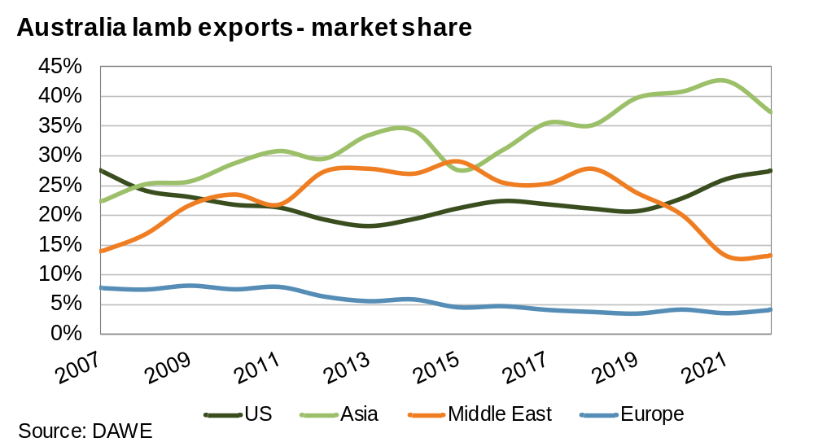
The influence of China on red meat exports
Red meat export volumes impacted by flock & herd rebuild cycle
  Chinese share of beef exports holding as exporters maintain customers
  but lamb giving way to US demand.
Notes:
China still in our “top 3” export markets

Slide 25



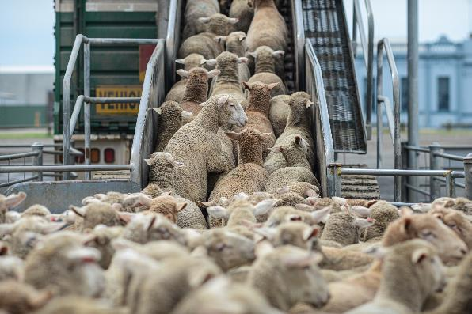
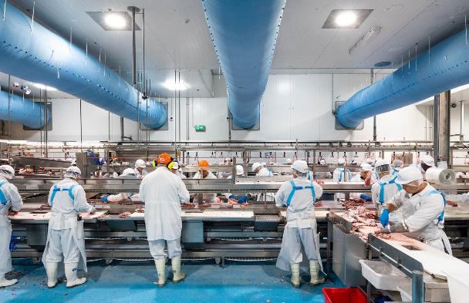
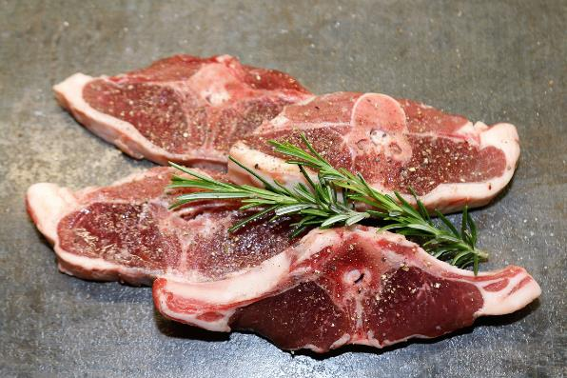
What’s ahead?
Flock expansion
Processing challenges?
Growing demand
Notes:
Supply
Strong incentive for producers to produce “more” sheepmeat. This will probably at the expense of Merino flock, as there is also a strong outlook for grain. Producers are retaining ewe sheep to expand their flocks, but any growth in the flock is expected to be modest. The story for the medium (& long term) is the world is demanding more high quality food protein.
Processing
Concerns. Many of the workers in abattoirs is seasonal labour workforce and backpackers, which we don’t have a lot of this year. Also Melb COVID-19 restrictions on meat processors reducing workforces by 20% . Acknowledge that processors have done a remarkable job in the face of serious challenges this season.
Demand
Domesitc lamb market – hot and cold in the last 2 years
……. but growing demand of our export markets, as well as further diversity a good thingh
…… positive signs ahead like the free trade agreement with the UK & India and growing demand for red meat in general as developing countries have more people moving into middle income category

Slide 26
WOOL & FIBRE
Price & Outlook Update

Slide 27
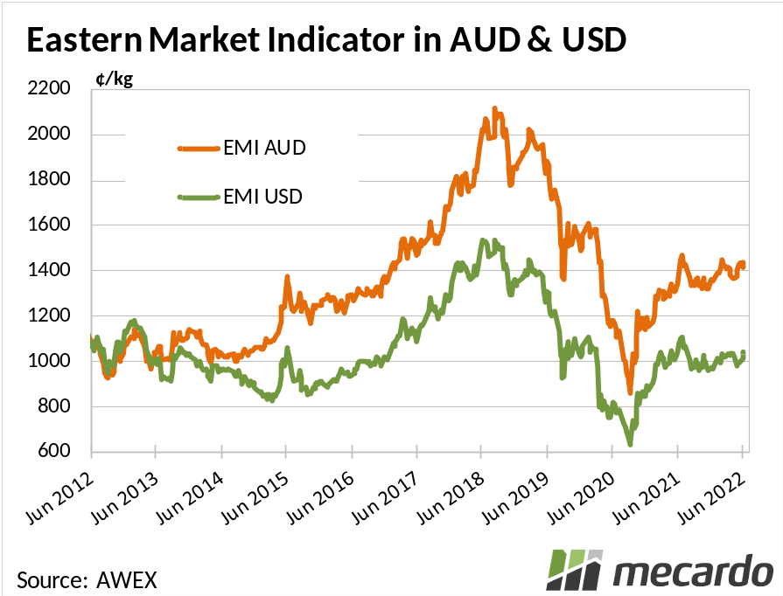
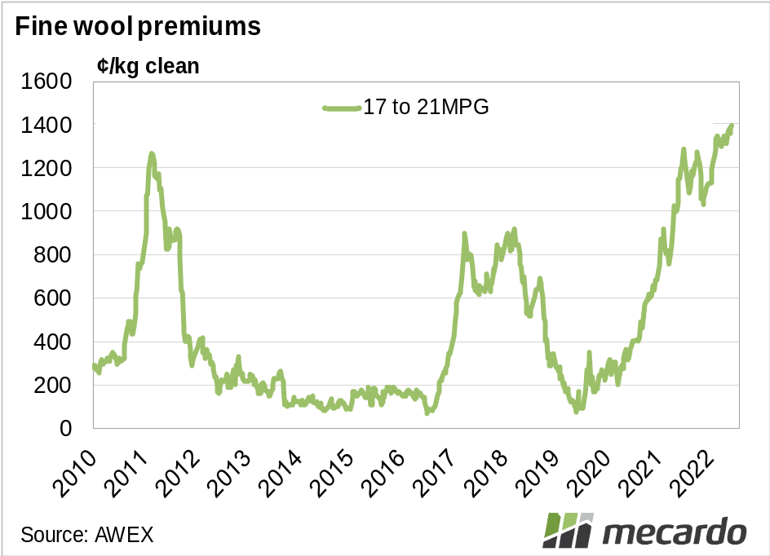
Wool price recovered
Recovered from CV downturn
Fine wool premium
Drought effect over
Notes:
2 downturns bolted together.
No one picked goods would fair so well through pandemic
Prices are good, and fine wool premiums look to be returning
The outlook is solid with a lower Au$ assisting
Record wool prices in domestic terms for much of the finer/medium fibres. Lower A$ sees wool prices in foreign terms 10-15% below recent peaks suggesting demand will remain firm, lower but stabilising supply will continue to provide support to wool prices at current levels
Linked Chart: Y:\ACU Commodities\ACU Wool\Market Data\WEEKLY WOOL PRICE TABLE.XLSX
Sheet: Market Comments
OPTIMAL CHART SIZE: 8X14; POS: TLH H/V 2/9
Linked Chart: Y:\ACU Commodities\ACU Wool\Market Data\WEEKLY WOOL PRICE TABLE.XLSX
Sheet: Mecardo Charts
OPTIMAL CHART SIZE: 8X14; POS: TLH H/V 18/9

Slide 28
Along for the ride with apparel fibres
Source: AWEX, RBA, Emerging Textiles, Independent Commodity Services P/L
Notes:
Of course wool does not operate in a vacuum but in competition and cooperation with a wide range of other fibres including cotton, polyster, acrylic and silk so has this cycle we’ve seen in merino, pretty consistent with other fibres?

Slide 29
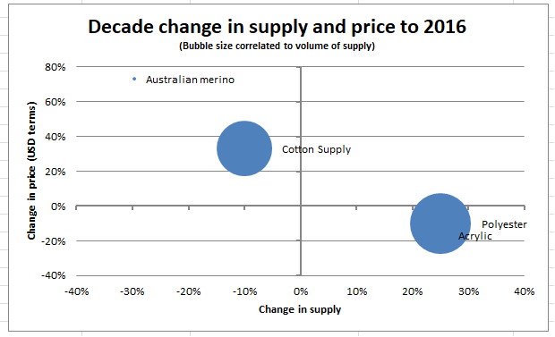
Supply & Price – they are not isolated
Supply down …. Price higher
But the big fibers are cotton & synthetics
Source: Independent Commodity Services P/L
Notes:
Despite the strong wool prices, supply remains under pressure. Initially it was disillusionment with wool prices causing increased acres directed towards cropping and prime lamb production, however in recent times it has been the poor season that has limited any flock rebuild and in fact has seen further destocking in some arrears.
The price of wool has been supported with the reduction in supply. Given the scale of the competing fibres (cotton & synthetics) the shortfall in wool supply to the market will be met, and the price will then realign with competing fibres.

Slide 30
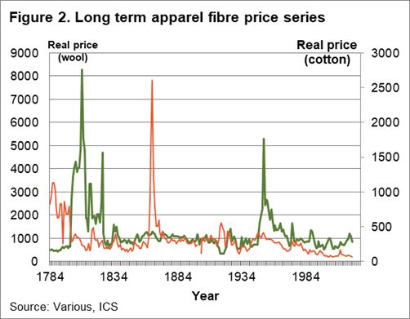
Long game for fibre prices ……!
Industrial Revolution
Korean War
US Civil War
Notes:
Wool has performed relatively well compared to competitors
Note cotton fibres price trajectory
Industrial revolution 1760 -1840, Crimean War 1853 – 1856, US Civil War 1861 - 1865

Slide 31

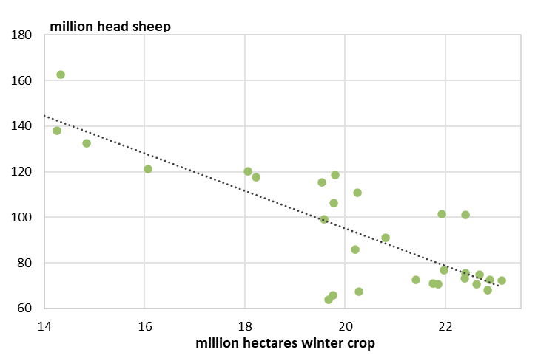
…growth in crop area here to stay?
So how/why has grain been winning the “fight for acres”?
1990-91
2020-21
Source: ABS, Mecardo
Notes:
Discuss price risk – global supply, seasonal risk – drought
Correlations broken now.
Sheep numbers stabilised- drought.
Factors- management investment funds w forestry ran out in 2010, drought has really masked stabilisation

Slide 32
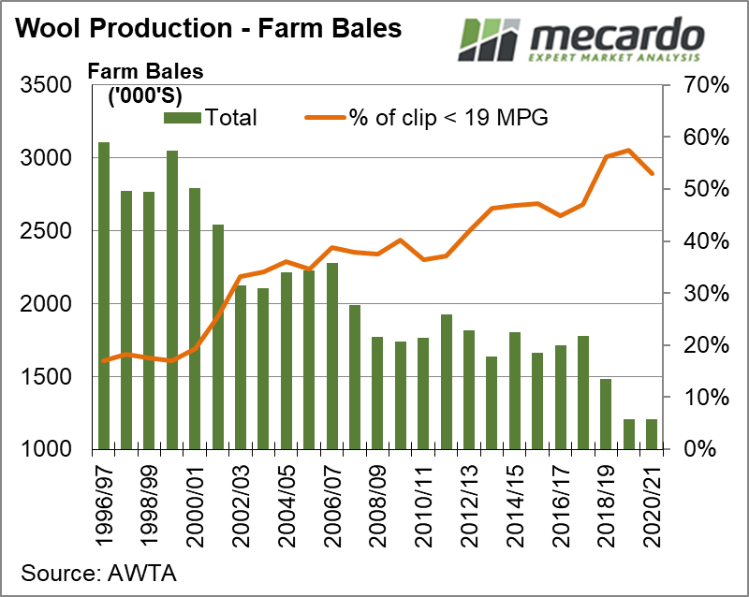
Notes:
The Merino flock (and therefore wool production) has dramatically fallen since the late 1990’s
Still a challenge to increase Merino numbers – has the fight for acres already been lost?
Prices have been supported by falling volume
However fine wool volume has distorted the fine wool market
Better outlook for prices will at least sustain the current wool volume

Slide 33
Quality scheme supply - Australia
Source: AWEX, Independent Commodity Services P/L

Slide 34
Quality head to head – AUS vs South Africa
Source: Cape Wools, RBA, AWEX, Independent Commodity Services P/L

Slide 35
Do Quality credentials pay off?
Source: AWEX, Independent Commodity Services P/L
Notes:
Based on AWEX auction data, premiums for 21 MPG & finer have been in the order of 150 to 275 cents per kg clean.
RWS premiums are the standout

Slide 36

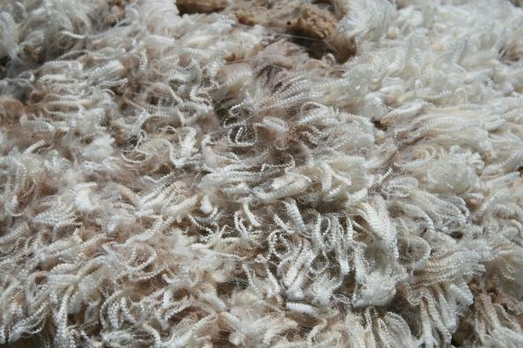
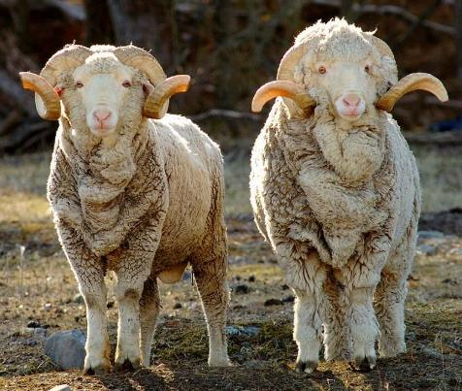
What’s ahead for wool?
Flock expansion
Processing challenges?
Growing demand
Notes:
Supply
Producers are retaining ewe sheep to expand their flocks, but the challenge of labour means the Merino flock is under pressure. Production is up 5/6% y on y due to good season, with another 2/3% increase forecast due to increased flock for 22/2023
Processing
Dark cloud. CV restrictions in mills, holding up wool payments and causing finance challenges for exporters.
Demand
Demand is strong, especially for QA assured wool, RWS is the leader in this space at the moment.

Slide 37

GRAINS
Price & Outlook Update

Slide 38
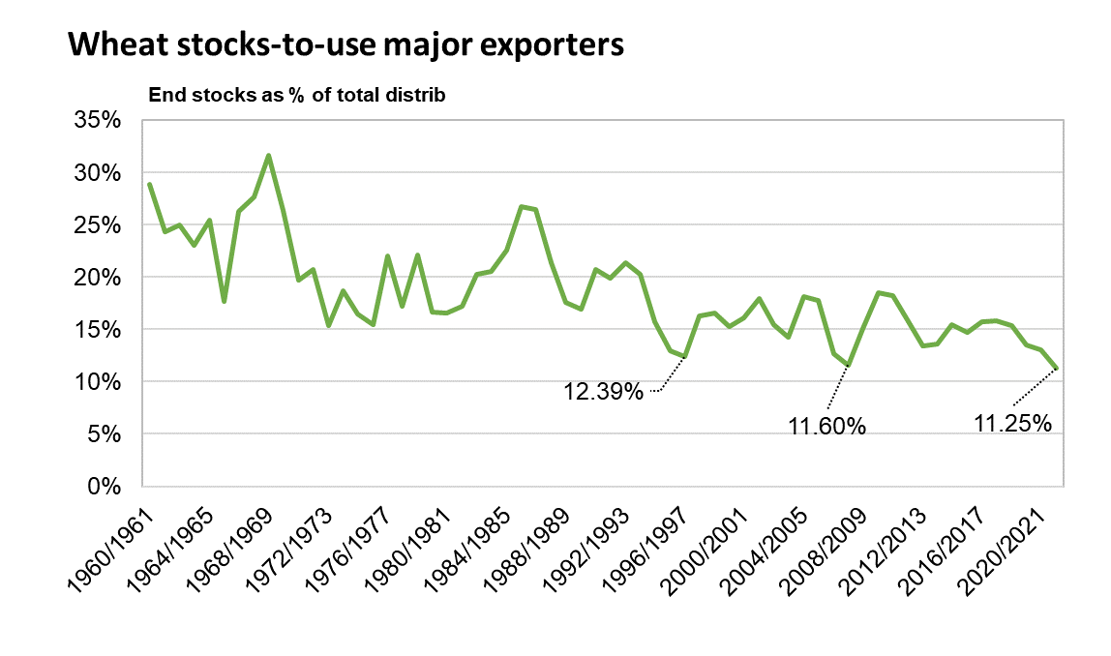
Global exporter’s wheat stocks are tightening
World demand for wheat outstripping supply
2020/21 stocks-to-use of major exporters at record low
Scarcity drives price higher, and demand for substitutes
Notes:
SUPPLY STORY
World demand for wheat outstripping supply – little carry over from last season, US & Canada drought.
Stocks in major exporting countries, which include the US, Australia, Canada, Russia, Ukraine and Argentina have been shrinking compared to the combined demand created by their domestic use, and expanding export programs.
Record low in 2020/21
As stocks to use ratios fall, scarcity of wheat increases, and shocks like the Ukraine war can cause more extreme price movements.
Adding fuel to the fire - and this has the potential to be a big story – is news out of China suggesting their winter wheat crop could be ‘worst in history’. China produced 134mmt of wheat last year, of which ~90% was winter wheat. The majority of wheat is consumed domestically or stored (recall China is supposed to hold 51% of the worlds surplus stock). The issue was a very wet planting period leading to sowing delays and water logging. If China emerges as a major buyer in 22/23, it may have the effect of drawing down already tight stocks.
Linked Chart: Y:\ACU Commodities\ACU Grain\New Market Data File\20210927- Wheat Futures and forward curves.xlsx
Sheet: FORWARD CURVE CORN
OPTIMAL CHART SIZE: 12X20; POS: TLH H/V 18/4

Slide 39
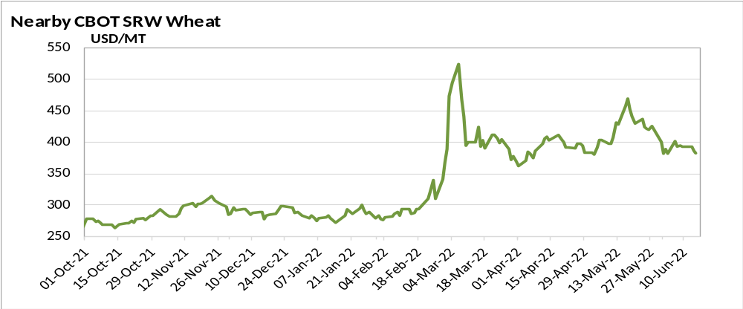
Wheat market response to war
US CBOT up $AU 320 (80%) from 1st Feb at peak
Risk premium built in
Panicked market
07-Mar :
Peak @ $524/mt
$AU 715 mt
11-Feb:
Credible Intel of Russian Attack
24-Feb:
Russia Invades Ukraine
13-Nov:
Ukraine protests 100K Russian troops at border
16-JUN :
$383/mt
$540AU /mt
21-Feb:
Russia Enters Donetsk region
Source: Refinitiv, Mecardo
Notes:
PRICE-
So now comes the interesting part. PRICE
The chart on screen at the moment is CBOT SRW wheat contract for May and you can see that in November when Russian troops started building along the Ukraine border the futures price rose and a risk premium built into the market. It wasn’t until February though when intelligence of Russia moving into the Donetsk region was released that the trade really comprehended an invasion and then it’s quite clear to see when the invasion occurred wheat futures surged, hitting daily limits, increased about 34%. Which came down to the shutdown of ports in Ukraine and in the sea of Azov, but also concern over what the sanctions on Russia would mean for wheat supply.
But we’ve also seen this extreme volatility where the price is just like a yoyo as there are so many moving parts and pieces of information to this. Rumours that Russia may suspend exports of wheat, rye barley and corn have emerged, and yet evidence of renewed grain exports are starting to move out of Russia. So we are seeing this vortex of information that the trade is trying to comprehend which is leading to this volatility.
Linked Chart: Y:\ACU Commodities\ACU Grain\New Market Data File\Grain Futures.xlsx
Sheet: FORWARD Market Comment
OPTIMAL CHART SIZE: 10X24; POS: TLH H/V 5/6
[Chart data range & axis required manual updating]

Slide 40






Market Drivers
Ukraine war likely to drag on for some time.
Sanction impact on Russia economy & occupied Ukraine
Ukrainian ports closed by conflict
Ukrainian and Russian farm production at risk in 2022/23
Developing weather issues in US, China, South America & EU
Australian shipping at capacity
China COVID lockdowns dragging on growth
Export bans in response to escalating food security concerns.
Notes:
Everything hinges on how long the war rages in Ukraine, and what impact sanctions have on the flow of Russian grain into world markets.
An extended war will be disastrous for world wheat supply, with Ukrainian and Russian production likely to be curtailed, as well as the ability for them to export via sea ports.
And whether Australian growers will see much price benefit will hinge on the length of the war due to our logistic constraints.
China’s pursuit of a Zero COVID strategy could put a sizable dampener on consumer sentiment, and economic growth in the region, particularly regarding premium red meats destined for foodservice channels. The sole benefit is it may help keep a lid on oil prices.
Increasing numbers of countries are implementing export bans on various agricultural commodities
Indonesia- palm oil export ban
India- wheat export ban (whether it is implemented in practice is questionable though)
Russia- Wheat & sunflower oil export bans.

